Slide 1
Sections 11.6-11.8
Phase Diagrams, Structures of Solids, Bonding in Solids

Slide 2
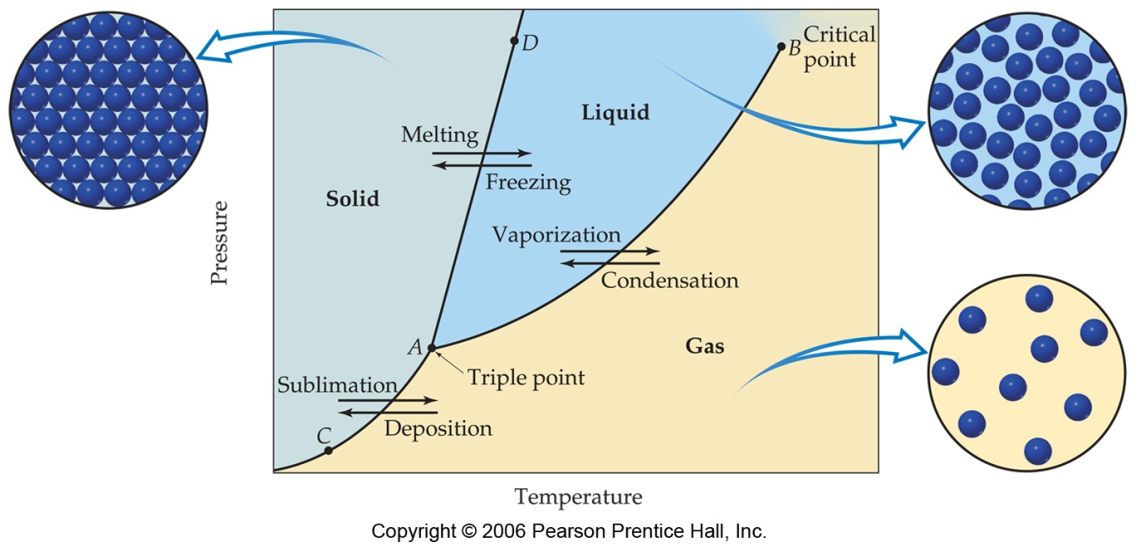
Phase Diagrams
Phase diagrams display the state of a substance at various pressures and temperatures and the places where equilibria exist between phases.

Slide 3
Phase Diagrams
The AB line is the liquid-vapor interface.
It starts at the triple point (A), the point at which all three states are in equilibrium.

Slide 4
Phase Diagrams
It ends at the critical point (B); above this critical temperature and critical pressure the liquid and vapor are indistinguishable from each other.

Slide 5
Phase Diagrams
Each point along this line is the boiling point of the substance at that pressure.

Slide 6
Phase Diagrams
The AD line is the interface between liquid and solid.
The melting point at each pressure can be found along this line.

Slide 7
Phase Diagrams
Below A the substance cannot exist in the liquid state.
Along the AC line the solid and gas phases are in equilibrium; the sublimation point at each pressure is along this line.

Slide 8
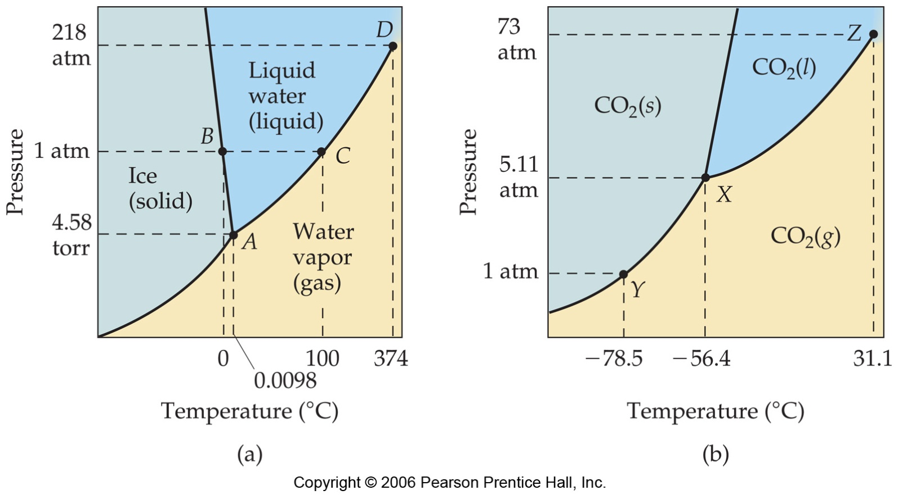
Phase Diagram of Water
Note the high critical temperature and critical pressure:
  These are due to the strong van der Waals forces between water molecules.

Slide 9
Phase Diagram of Water
The slope of the solid–liquid line is negative.
  This means that as the pressure is increased at a temperature just below the melting point, water goes from a solid to a liquid.

Slide 10
Phase Diagram of Carbon Dioxide
Carbon dioxide cannot exist in the liquid state at pressures below 5.11 atm; CO₂ sublimes at normal pressures.

Slide 11
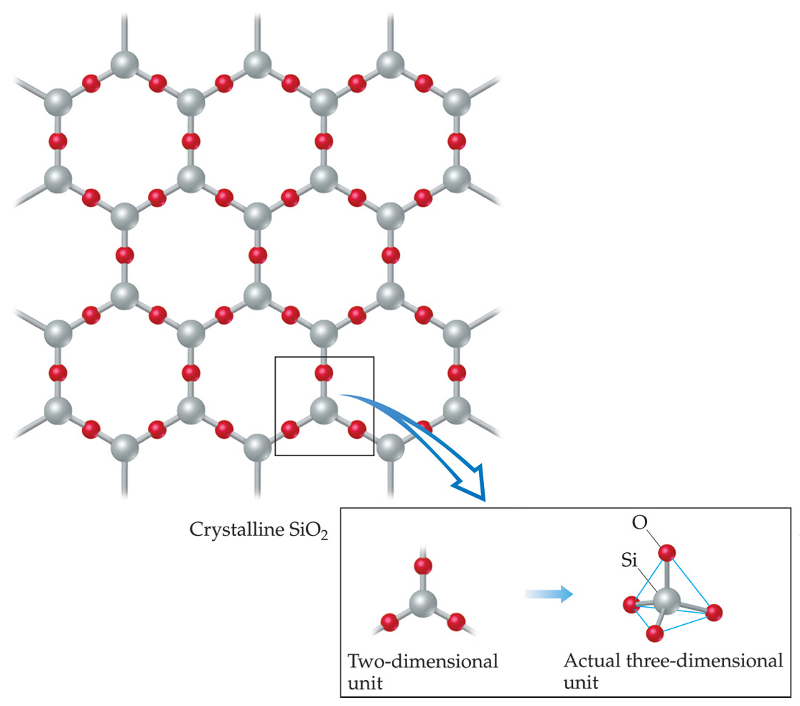
Solids
We can think of solids as falling into two groups:
  1) Crystalline—particles are in highly ordered arrangement.
  Have “faces” : flat surfaces and definite angles
  Melt at specific temp

Slide 12
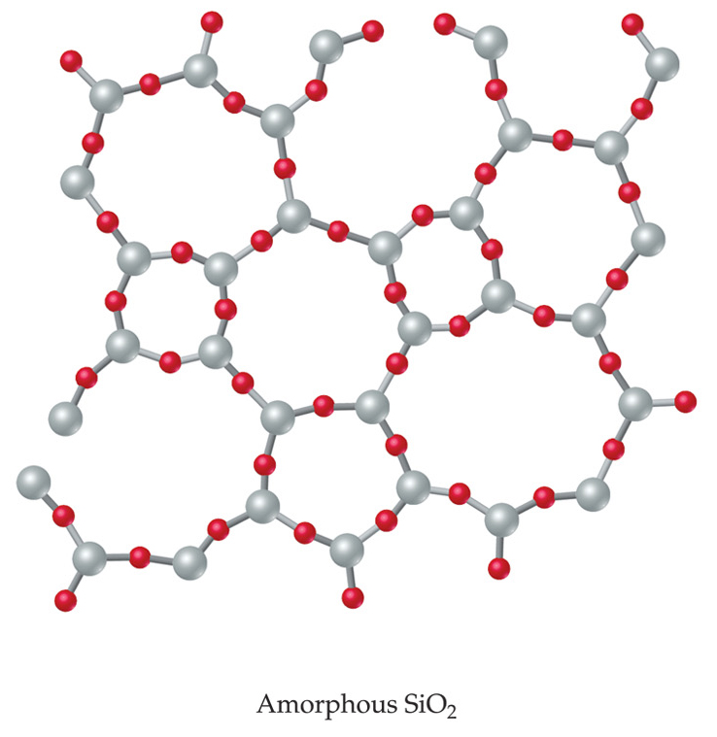
Solids
  2) Amorphous—no particular order in the arrangement of particles.
  Intermolecular forces vary throughout
  Do not melt at specific temperatures
  Soften over a temp range

Slide 13
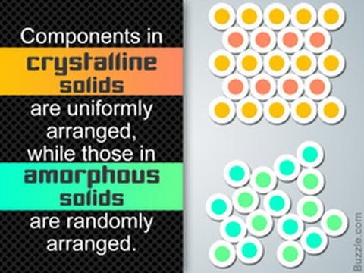

Slide 14
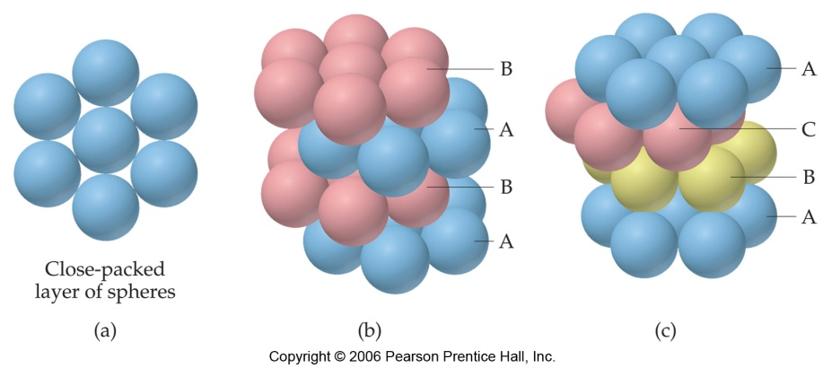
Attractions in Ionic Crystals
In ionic crystals, ions pack themselves so as to maximize the attractions and minimize repulsions between the ions.

Slide 15
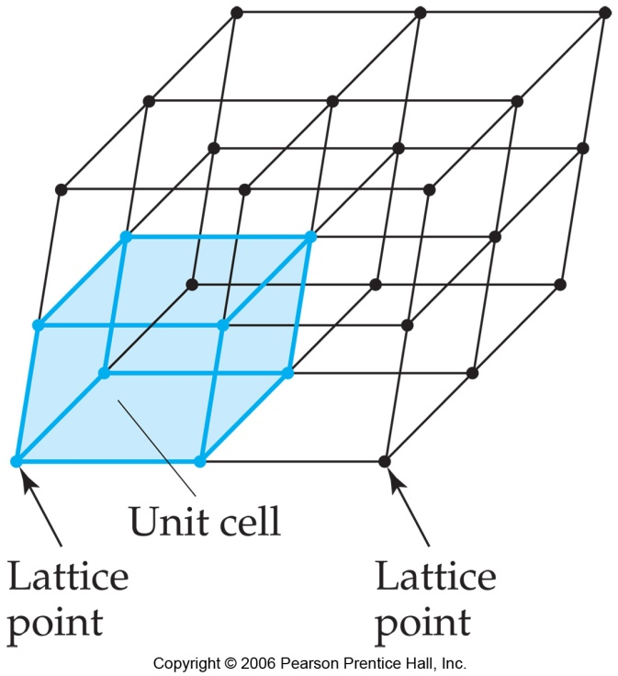
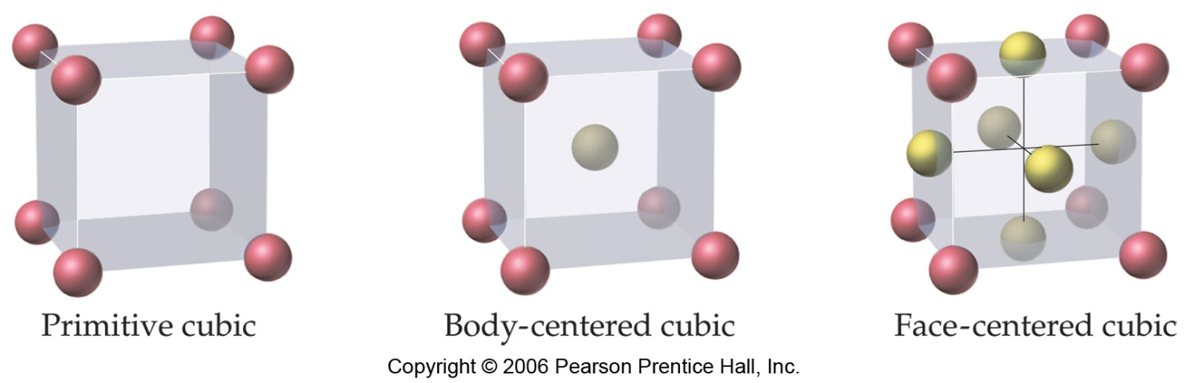
Crystalline Solids
Because of the order in a crystal, we can focus on the repeating pattern of arrangement called the unit cell.

Slide 16
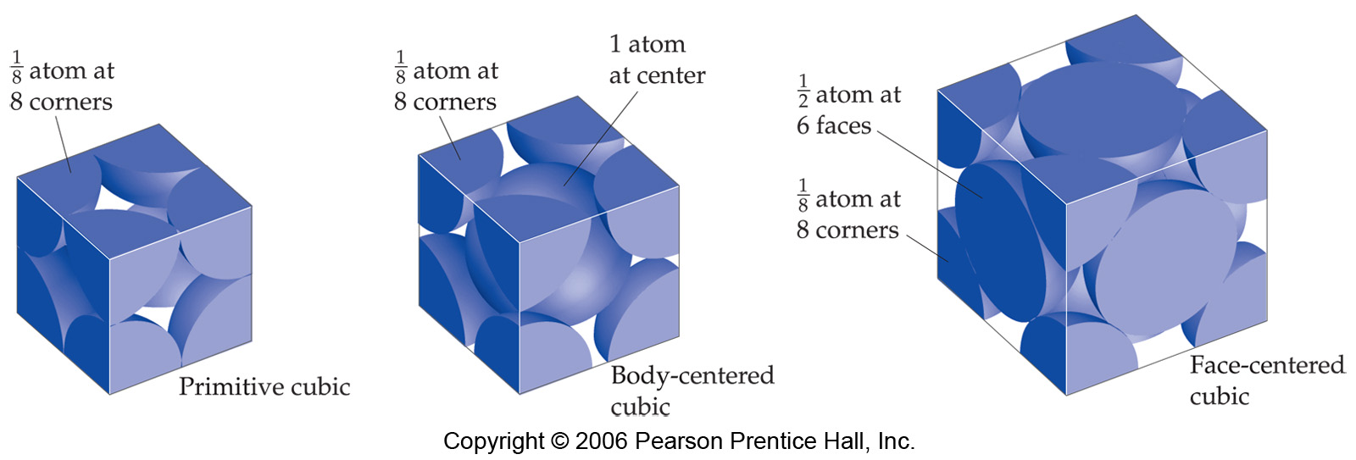
Crystalline Solids
There are several types of basic arrangements in crystals, such as the ones shown above.

Slide 17
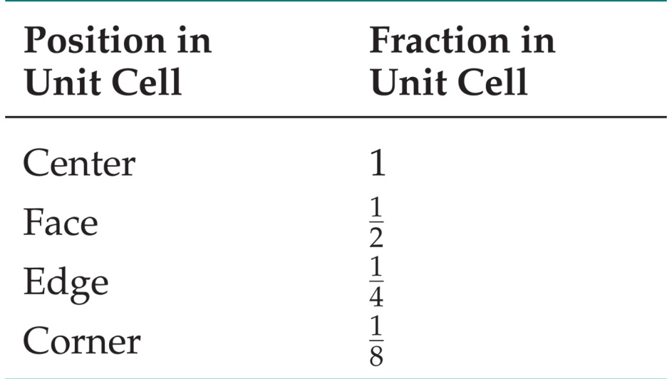
Crystalline Solids
We can determine the empirical formula of an ionic solid by determining how many ions of each element fall within the unit cell.

Slide 18
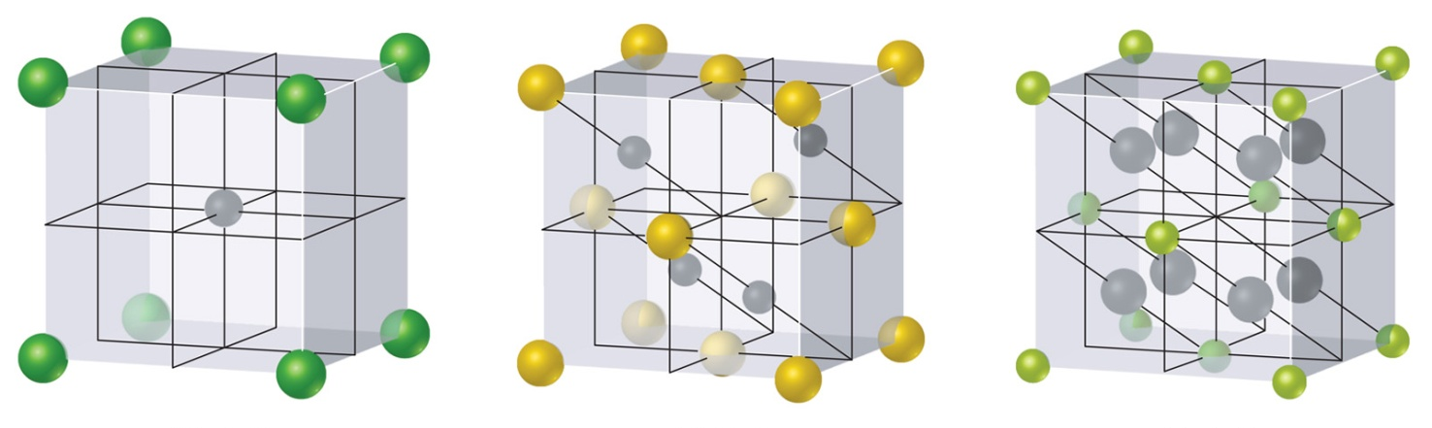
Ionic Solids
What are the empirical formulas for these compounds?
  (a) Green: chlorine; Gray: cesium
  (b) Yellow: sulfur; Gray: zinc
  (c) Green: calcium; Gray: fluorine
(a)
(b)
(c)
CsCl
ZnS
CaF₂

Slide 19
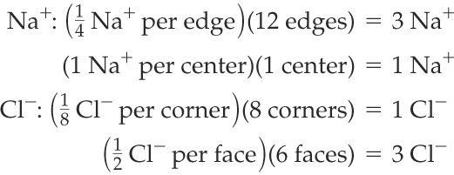


SAMPLE EXERCISE 11.7 Determining the Contents of a Unit Cell
Determine the net number of Na⁺ and Cl– ions in the NaCl unit cell (Figure 11.36).
Solution
Analyze: We must sum the various contributing elements to determine the number of Na⁺ and Cl– ions within the unit cell.
Plan: To find the total number of ions of each type, we must identify the different locations within the unit cell and determine the fraction of the ion that lies within the unit cell boundaries.
Solve: There is one-fourth of an Na⁺ on each edge, a whole Na⁺ in the center of the cube (refer also to
Figure 11.35), one-eighth of a Cl– on each corner, and one-half of a Cl– on each face. Thus, we have the following:
Thus, the unit cell contains
Check: This result agrees with the compound’s stoichiometry:
PRACTICE EXERCISE
The element iron crystallizes in a form called α-iron which has a body-centered cubic unit cell. How many iron atoms are in the unit cell?
Answer: two

Slide 20
SAMPLE EXERCISE 11.8 Using the Contents and Dimensions of a
Unit Cell to Calculate Density
The geometric arrangement of ions in crystals of LiF is the same as that in NaCl. The unit cell of LiF is 4.02 Å on an edge. Calculate the density of LiF.
Solution
Analyze: We are asked to calculate the density of LiF from the size of the unit cell.
Plan: We need to determine the number of formula units of LiF within the unit cell. From that, we can calculate the total mass within the unit cell. Because we know the mass and can calculate the volume of the unit cell, we can then calculate density.
Solve: The arrangement of ions in LiF is the same as that in NaCl (Sample Exercise 11.7), so a unit cell of LiF contains
4 Li⁺ ions and 4 F– ions.
Density measures mass per unit volume. Thus, we can calculate the density of LiF from the mass contained in a unit cell and the volume of the unit cell. The mass contained in one unit cell is
4(6.94 amu) + 4(19.0 amu) = 103.8 amu
The volume of a cube of length a on an edge is a³, so the volume of the unit cell is (4.02 Å)³. We can now calculate the density, converting to the common units of g/cm³.

Slide 21
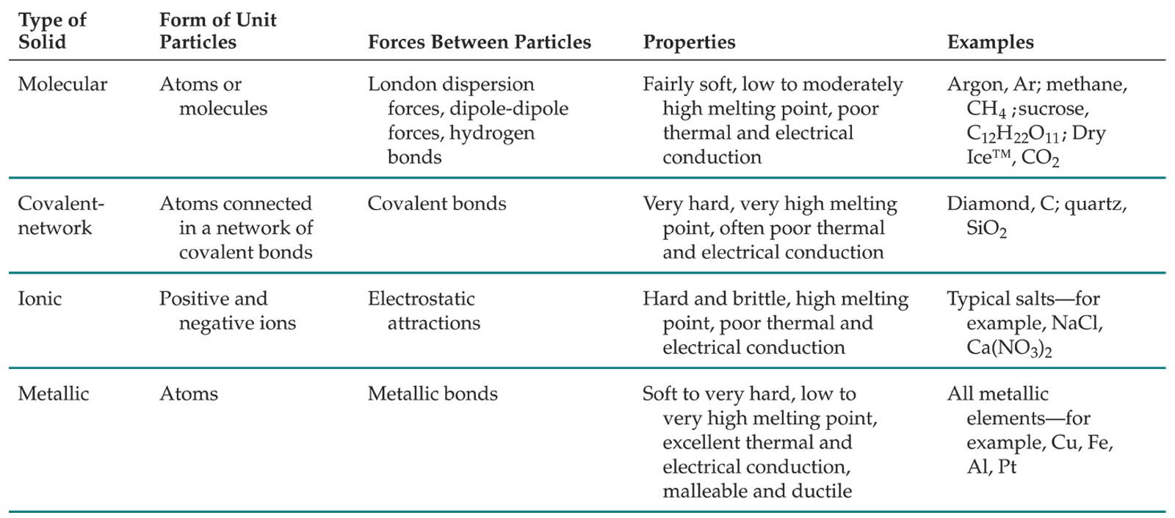
Types of Bonding in Crystalline Solids

